Slide 1

Sales Report
Project Name: Superstore Sales Analysis
Your Name: Mirtunjay Kumar
Tools Used: Python, pandas, seaborn, scikit-learn, statsmodels
Date or Portfolio Tagline:- A complete data analysis and machine learning project
Sales Reports by Mirtunjay kumar

Slide 2

Overview
This project analyzes sales data from a fictional Superstore. It explores trends in sales, profit, discounts, and shipping. Using data visualization and machine learning, it predicts whether orders are profitable and forecasts future sales using time series modeling

Slide 3
Objective
_01
Understand sales and profit patterns across regions, categories, and discounts
Identify the relationship between discount levels and losses
Predict whether an order will be profitable using Random Forest
Forecast monthly sales for the next 6 months using ARIMA

Slide 4

Tools & Technologies
Python (pandas, numpy) – Data analysis
Seaborn / Matplotlib – Data visualization
Scikit-learn – Random Forest classification
Statsmodels (ARIMA) – Time series forecasting
Jupyter Notebook – Project development

Slide 5
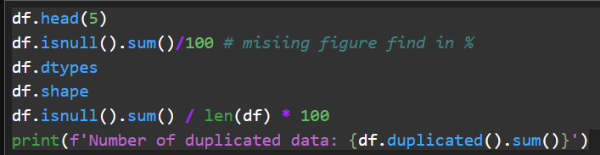
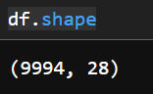
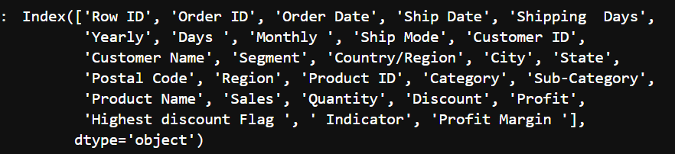
Missing Values & Duplicates Handling
Any number from 0-9
for a timer
C for confetti
B for blur
O for bubbles
D for a drumroll
X to close
Columns of Datasets
Q for quiet

Slide 6
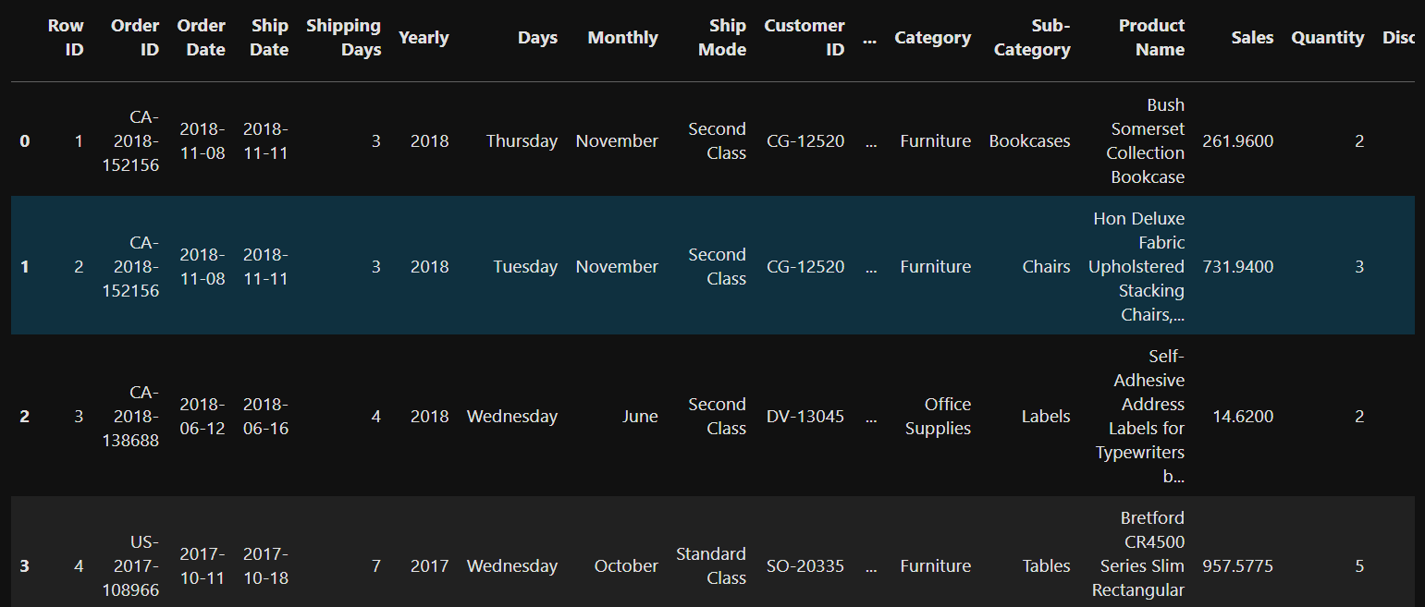
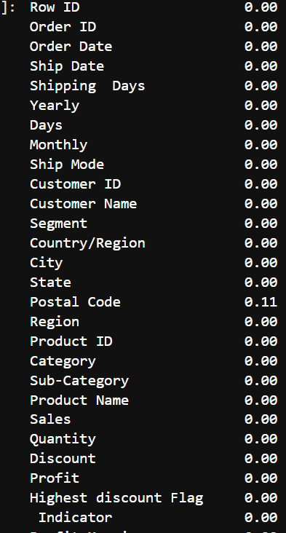

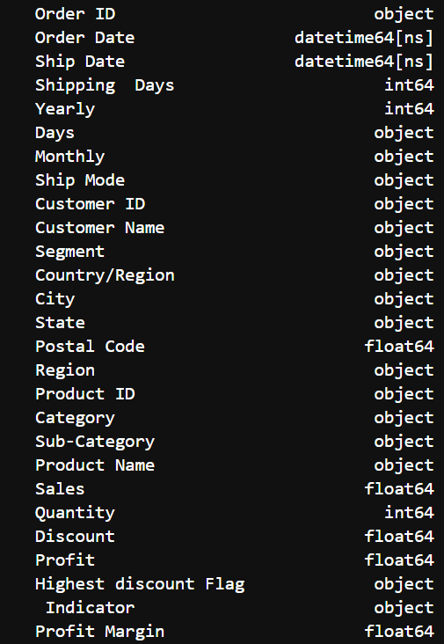
Head of dataset
_01
Missing Value
Data types Handling

Slide 7
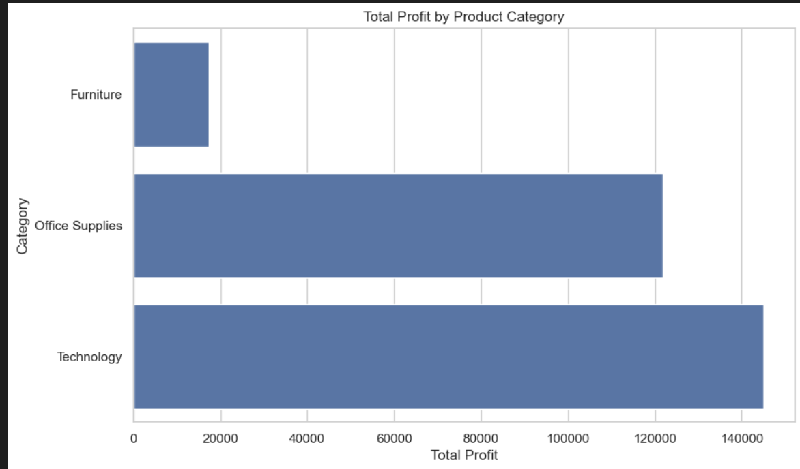
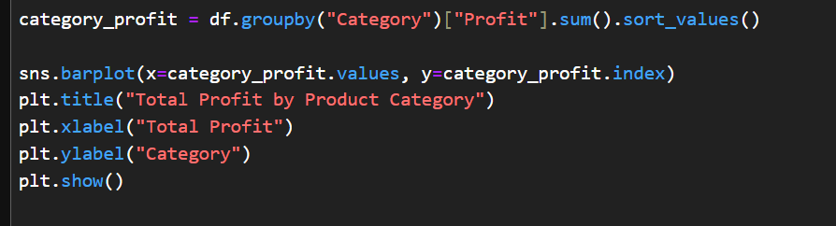
Category-Wise Profit Analysis – Focus Areas for Business Growth
* Profit by Product Category
- Technology leads in total profit, followed by Office Supplies.
- Furniture lags behind in profitability.
- This insight helps prioritize marketing efforts and cost control by category.

Slide 8
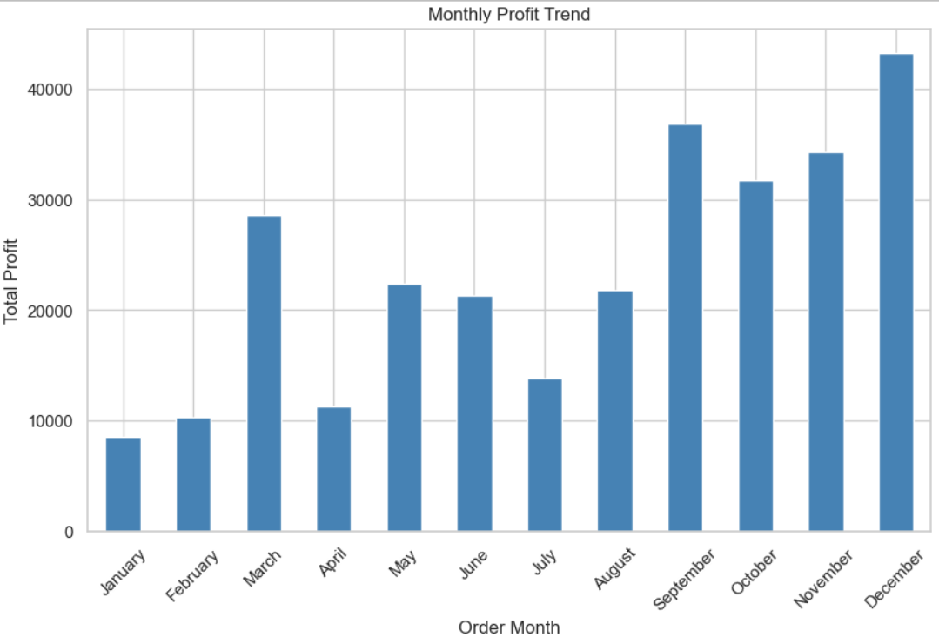
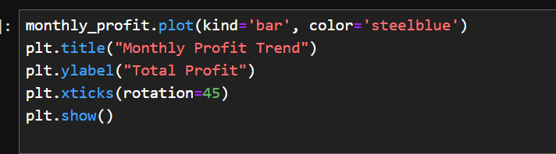
Monthly Profit Trend – Seasonality in Superstore Performance
Monthly Profit Trend
This visualization shows monthly profit fluctuations.
- December leads with the highest profit
- Q4 (Sep–Dec) consistently outperforms other months
- January and February are slow-performing months
- Insight helps drive seasonal marketing and operations planning

Slide 9
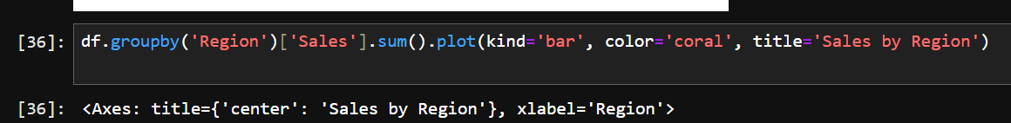
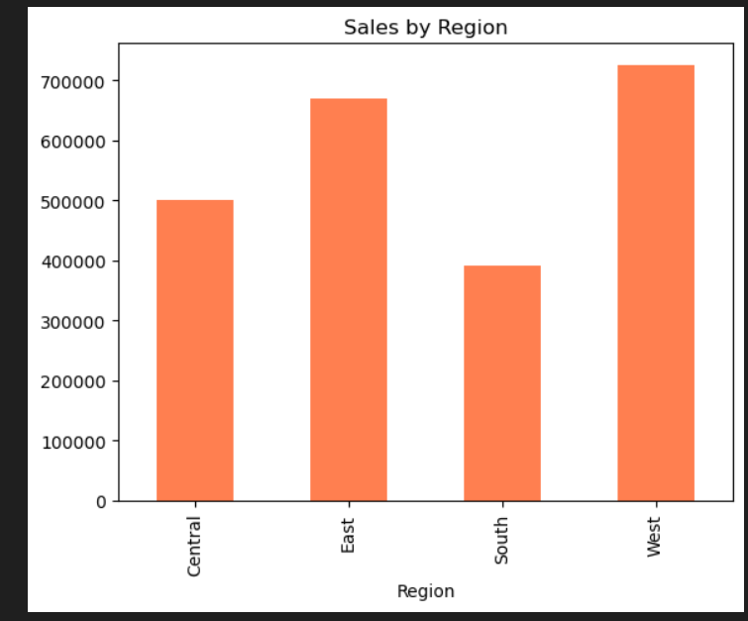
Regional Sales Distribution – Identifying Top Markets
Regional Sales Summary
- West region leads in total sales.
- East also performs strongly, nearly matching the West.
- South lags behind significantly—further analysis needed.
- Insight helps inform regional sales strategy and investment allocation.

Slide 10
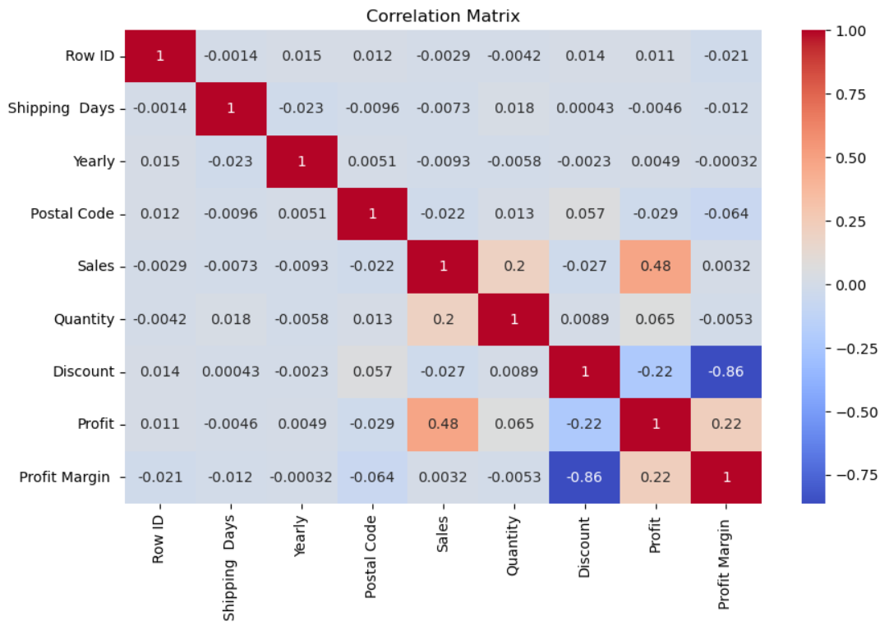
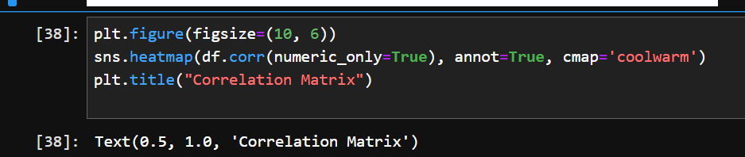
Correlation Analysis of Superstore Metrics
Correlation Analysis Summary
- Sales and Profit are moderately correlated (0.48)
- High Discounts strongly reduce Profit Margin (-0.86)
- Quantity sold slightly boosts Sales (0.20)
- Shipping Days and Postal Code show minimal impact

Slide 11
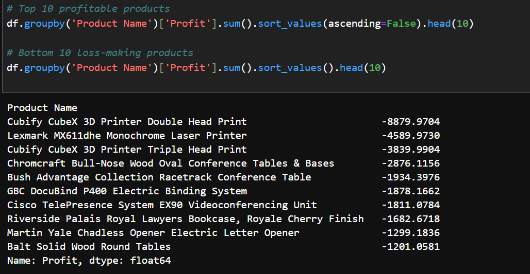
Loss-Making Products Analysis

Slide 12

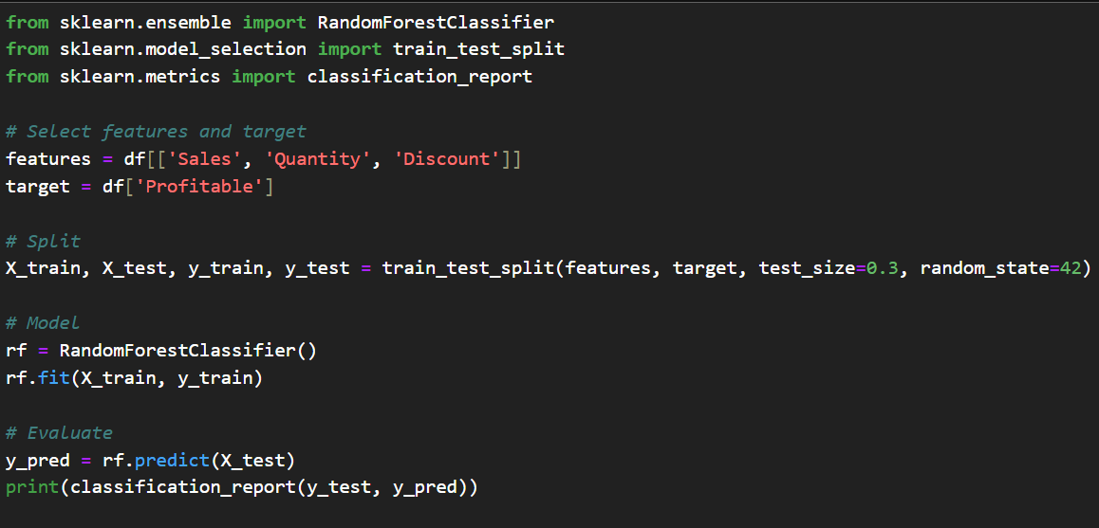
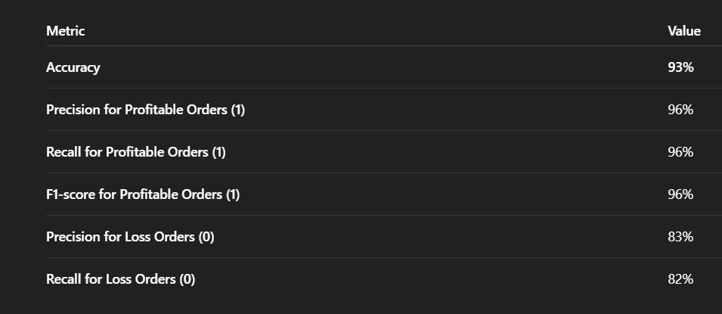
Profitability Prediction Using Random Forest Classifier

Slide 13

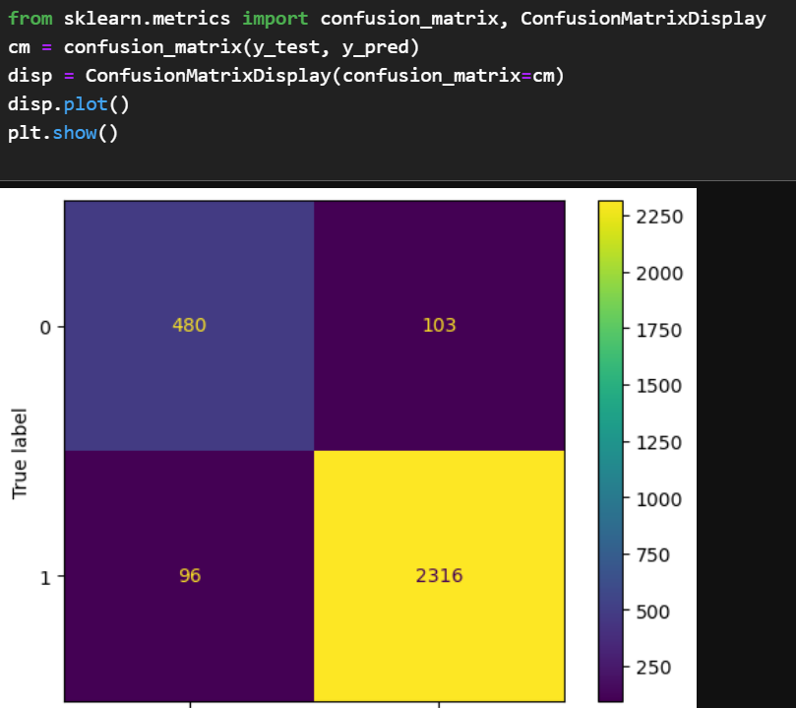
* Random Forest Classifier - Profitability Prediction
- Model achieves 93% overall accuracy.
- 96% of profitable orders correctly identified.
- Loss-making orders prediction can be improved slightly.
- Predictive model can be deployed to guide discount decisions and prevent losses.

Slide 14

Recommendations
Focus on Technology products and West region.
Review Furniture pricing and promotions.
Limit discounts to protect profit margins.
Boost campaigns during March and Q4 (Sep–Dec).
Improve marketing in South region.

Slide 15

Conclusion
Through detailed data analysis, machine learning modeling, and forecasting, we derived actionable insights that can help the Superstore optimize its sales strategy, maximize profits, and plan for sustainable future growth.”

Slide 16


Thank your for Time
Mail:- Mirtun1999@gmail.com
LinkedIn :- https://www.linkedin.com/in/mirtunjay-kumar23/
GitHub :-https://github.com/Mirtunjay24
Mirtunjay kumar
7979982592
Personal opinion “This project helped a retail business improve profits by analyzing sales trends and predicting risky orders.”
See you Next

